Slide 1
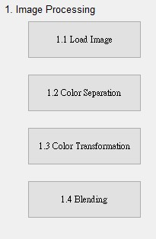
1. Image Processing (20%)
(出題: Tina)
1.1 Load Image File (5%)
1.2 Color Separation (5%)
1.3 Color Transformation (5%)
1.4 Blending(5%)

Slide 2
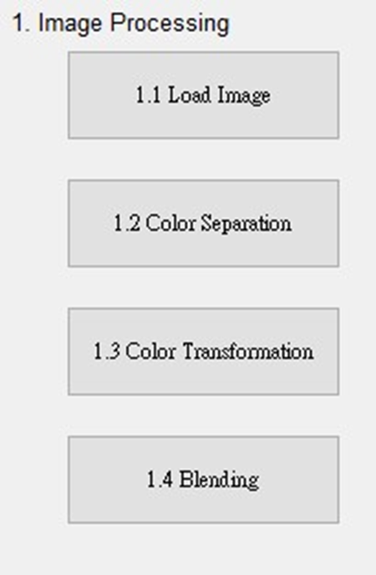
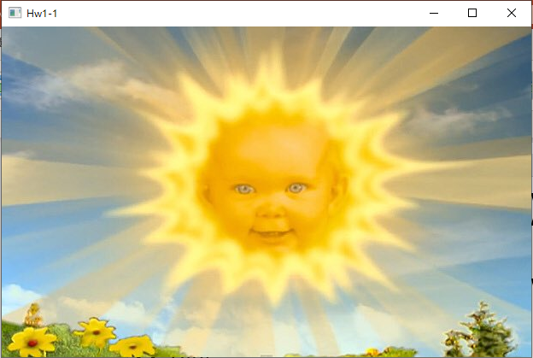
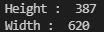
1.1 Load Image File (5%)
(出題：Tina)
Given: “Sun.jpg” image
Q: 1) Open a new window to show the image (Sun.jpg)
2) Show the height and width of the image in console mode
Hint :
Textbook Chapter 2, p. 22~23
cv2.imread(), cv2.imshow()

Slide 3
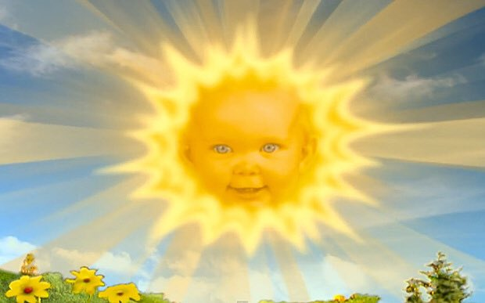
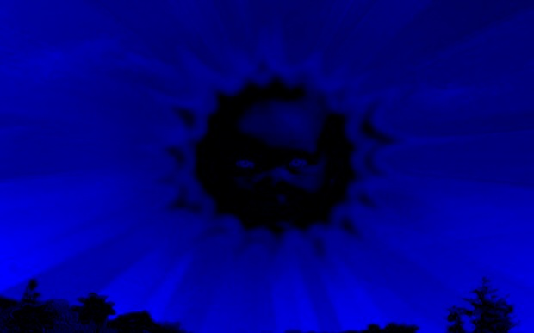
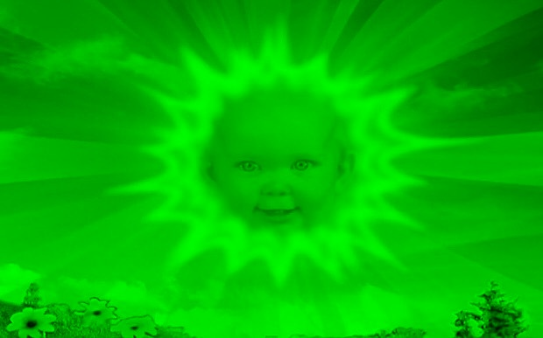
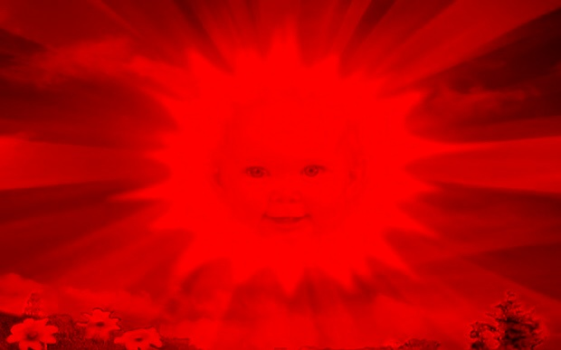
1.2 Color Separation (5%)
(出題：Tina)
Given: a color image, “Sun.jpg”
Q: 1) Extract 3 channels of the image BGR to 3 separated channels and show the result images.
Hint:
Textbook Chapter 3, p.31 ~ p.49
cv2.split(), cv2.merge()
Sun.jpg
B channel
G channel
R channel

Slide 4
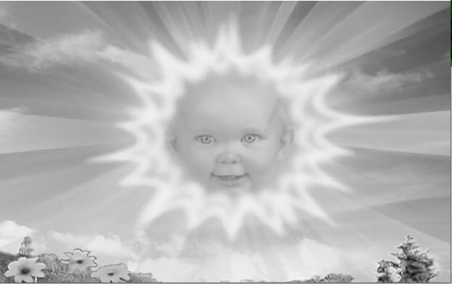
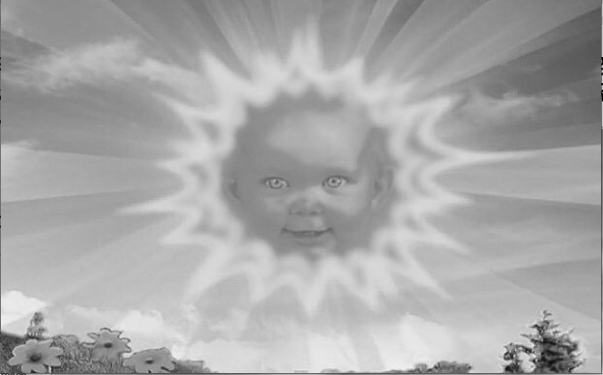
1.3 Color Transformation (5%)
(出題：Tina)
Given: 1 color image: “Sun.jpg”
Q: 1) Transform “Sun.jpg” into grayscale image I₁ by calling OpenCV function directly.
2) Merge BGR separated channel images from problem 1.2 into grayscale image I₂ by I₂ = (R+G+B)/3.
3) Show the above 2 results.
Hint:
Textbook Chapter 3, p.56 ~ p.59
cv2.cvtColor(…, cv2.COLOR_BGR2GRAY)
Sun.jpg
B channel
G channel
R channel
1) OpenCV function
2) Average weighted
I₁
I₂
Perceptually weighted formula:
I₁ = 0.07*B + 0.72*G + 0.21*R
Average weighted formula:
I₂ = (R+G+B)/3

Slide 5
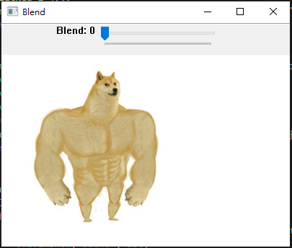
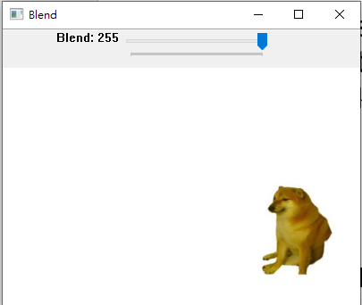
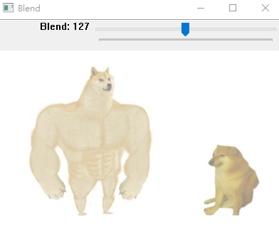
1.4 Blending (5%)
(出題：Tina)
Given: 2 images, “Dog_Strong.jpg” and “Dog_Weak.jpg”
Q: 1) Combine two images (Dog_Strong.jpg and Dog_Weak.jpg). 2) Use Trackbar to change the weights and show the result in the new window.
Hint:
Textbook Chapter 3, p. 50 ~ 52
cv2.addWeighted(), cv2.createTrackbar()
Demo:

Slide 6
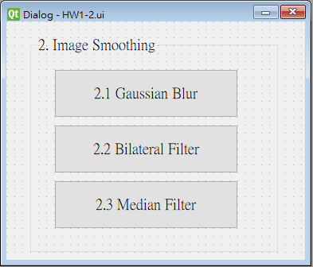
2. Image Smoothing (20%)
(出題: Willy)
2.1 Gaussian blur (5%)
2.2 Bilateral filter (5%)
2.3 Median filter (10%)

Slide 7
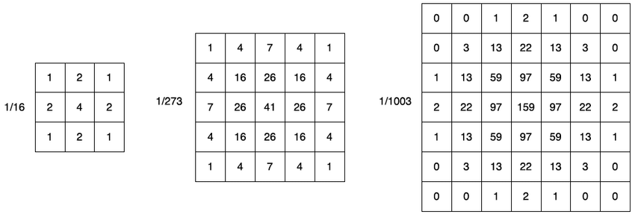


2.1 Gaussian Blur
(出題：Willy)
Given: a color image, “Lenna_whiteNoise.jpg”
Q: 1) Apply 5x5 Gaussian filter to “Lenna_whiteNoise.jpg”
Hint: Textbook Chapter 5, p.109 ~ p.115
Lenna_whiteNoise.jpg

Slide 8
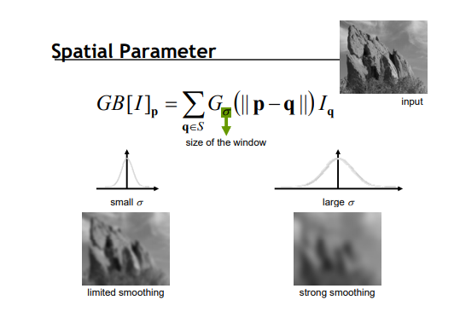

2.2 Bilateral Filter
(出題：Willy)
Given: a color image, “Lenna_whiteNoise.jpg”
Q: 1) Apply 9x9 Bilateral filter with 90 sigmaColor and 90 sigmaSpace to “Lenna_whiteNoise.jpg”
Hint: Textbook Chapter 5, p.109 ~ p.115
Lenna_whiteNoise.jpg

Slide 9
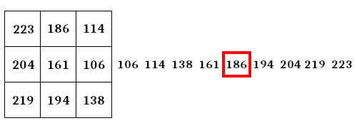
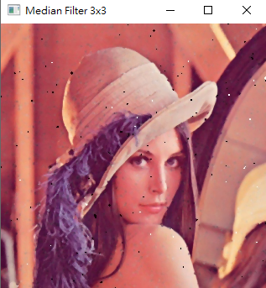

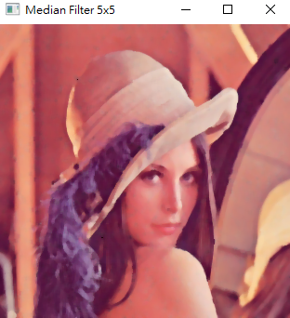
2.3 Median Filter
(出題：Willy)
Given: a color image, “Lenna_pepperSalt.jpg”
Q:
1) Apply 3x3 median filter to “Lenna_ pepperSalt.jpg”
2) Apply 5x5 median filter to “Lenna_ pepperSalt.jpg”
Hint: Textbook Chapter 5, p.109 ~ p.115
Median filter example
Lenna_pepperSalt.jpg
3x3
5x5

Slide 10
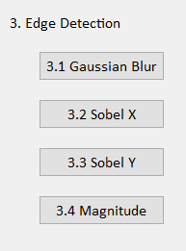
3. Edge Detection (20%)
(出題: Lydia)
3.1 Gaussian Blur (5%)
3.2 Sobel X (5%)
3.3 Sobel Y (5%)
3.4 Magnitude (5%)

Slide 11
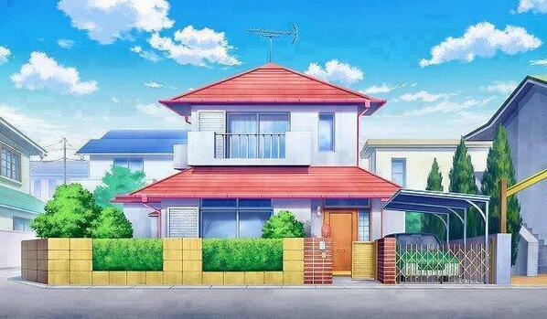
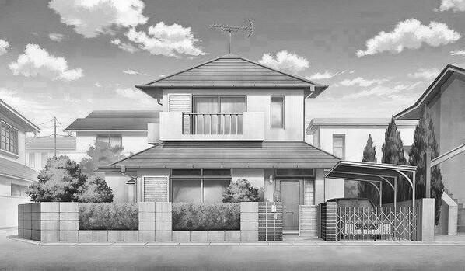

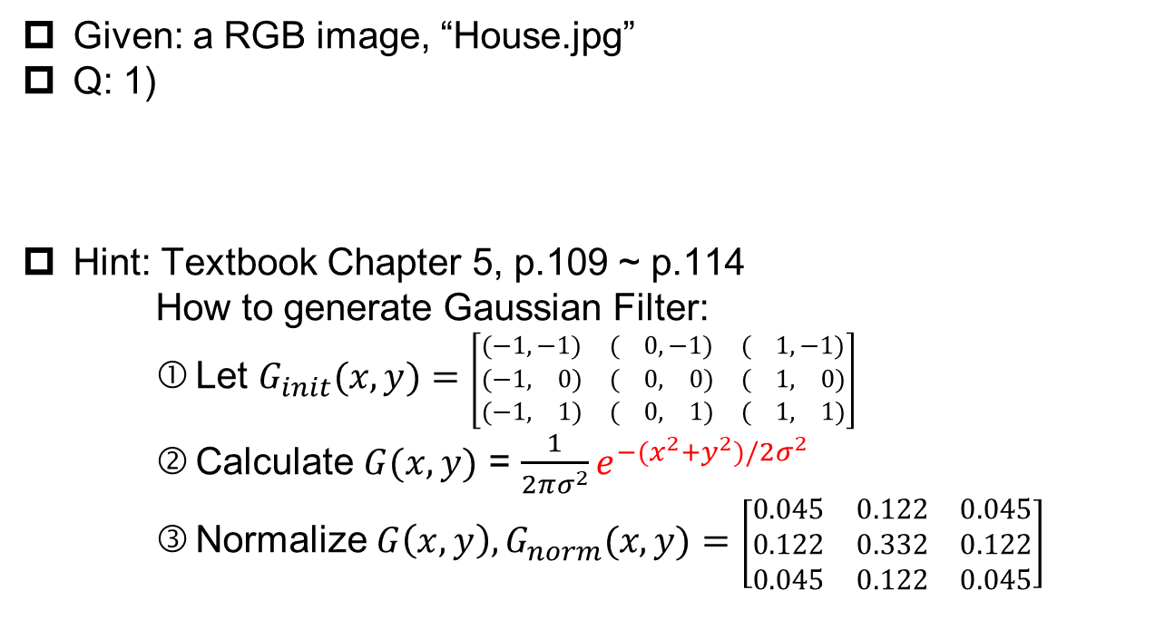
3.1 Gaussian Blur (5%)
(出題：Lydia)
Given: a RGB image, “House.jpg”
Q: 1)
Hint: Textbook Chapter 5, p.109 ~ p.114
How to generate Gaussian Filter:
Let $G_{init}(x, y)=$ $\left[\begin{matrix}(−1,−1) & ( 0,−1) & ( 1,−1) \\ (−1, 0) & ( 0, 0) & ( 1, 0) \\ (−1, 1) & ( 0, 1) & ( 1, 1)\end{matrix}\right]$
Calculate $G(x, y)$ = $\frac{1}{2πσ^{2}}e^{−(x^{2}+y^{2})/2σ^{2}}$
Normalize $G\left(x, y\right),G_{norm}(x, y)=$ $\left[\begin{matrix}0.045 & 0.122 & 0.045 \\ 0.122 & 0.332 & 0.122 \\ 0.045 & 0.122 & 0.045\end{matrix}\right]$
Gaussian Blur: Convert the RGB image into a grayscale image, then smooth it by your own 3x3 Gaussian smoothing filter (Can not use OpenCV Function). Please show the result.
House.jpg
Grayscale
Gaussian Blur

Slide 12
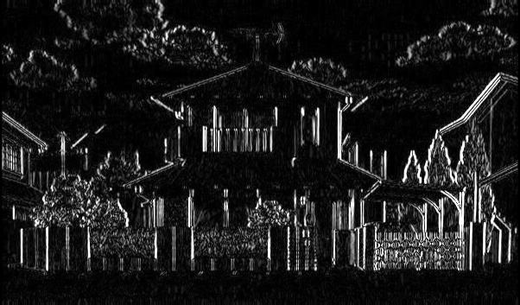
3.2 Sobel X (5%)
(出題：Lydia)
Given: the result of 3.1) Gaussian Blur
Q: 2)
Hint: Textbook Chapter 6, p.148 ~ 149
Sobel X: Use Sobel edge detection to detect vertical edge by your own 3x3 Sobel X operator (Can not use OpenCV Function). Please show the result.
-1 | 0 | 1
-2 | 0 | 2
-1 | 0 | 1
Sobel X Filter
Gaussian Blur
Sobel X

Slide 13
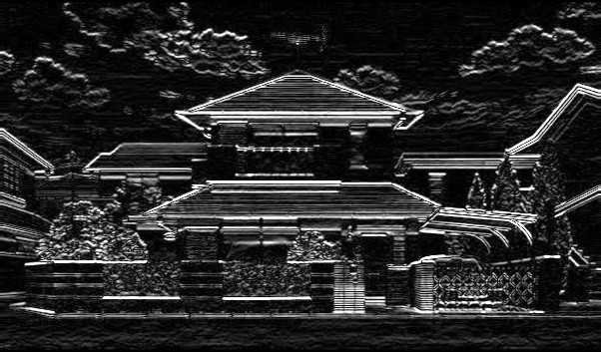
3.3 Sobel Y (5%)
(出題：Lydia)
Given: the result of 3.1) Gaussian Blur
Q: 3)
Hint: Textbook Chapter 6, p.148 ~ 149
Sobel Y: Use Sobel edge detection to detect horizontal edge by your own 3x3 Sobel Y operator (Can not use OpenCV Function). Please show the result.
1 | 2 | 1
0 | 0 | 0
-1 | -2 | -1
Sobel Y Filter
Gaussian Blur
Sobel Y

Slide 14
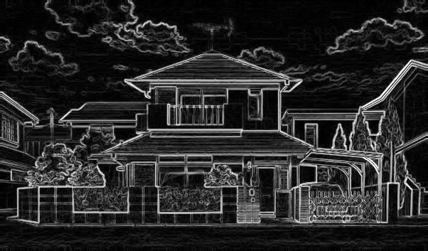
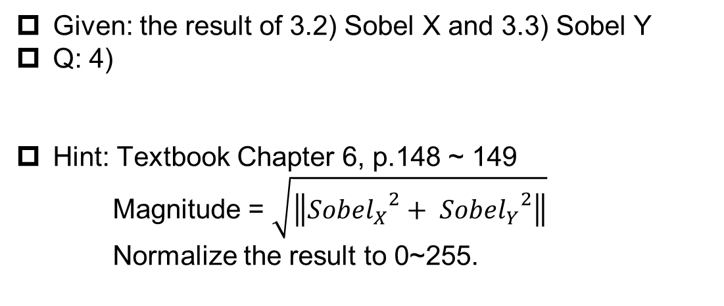
3.4 Magnitude (5%)
(出題：Lydia)
Given: the result of 3.2) Sobel X and 3.3) Sobel Y
Q: 4)
Hint: Textbook Chapter 6, p.148 ~ 149
Magnitude = $\sqrt{\left\|{{Sobel}_{X}}^{2}+ {{Sobel}_{Y}}^{2}\right\|}$
Normalize the result to 0~255.
Magnitude: Use the results of 3.2) Sobel X and 3.3) Sobel Y to calculate the magnitude. Please show the result.
Sobel X
Magnitude
Sobel Y

Slide 15
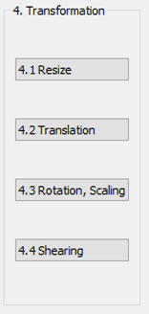
4. Transforms (20%)
(出題: Ray)
4.1 Resize (5%)
4.2 Translation(5%)
4.3 Rotation, Scaling (5%)
4.4 Shearing (5%)

Slide 16
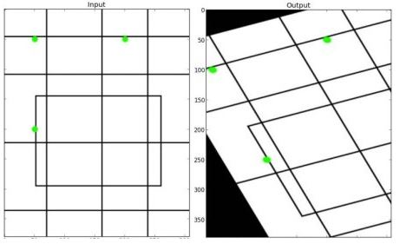
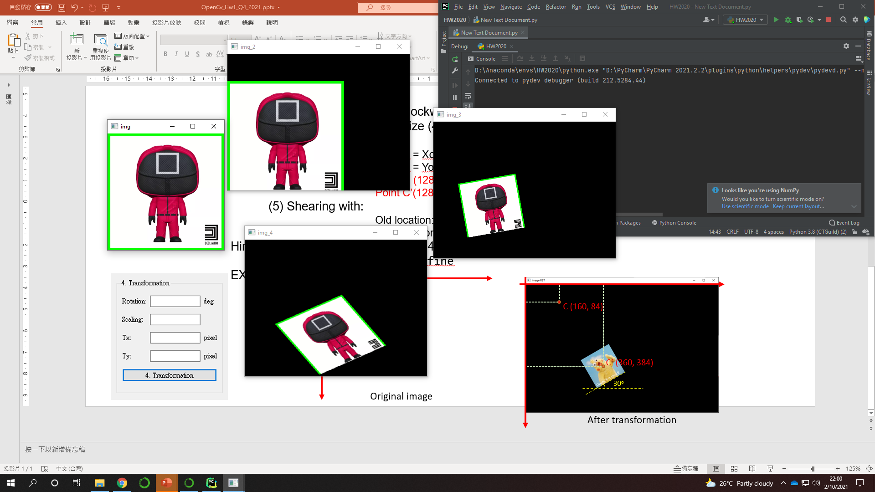
4. Transforms: Resize, Translation, Rotation, Scaling, Shearing(20%)
Given: “SQUARE-01.png”
Q:Please resize, translate , rotate, scale and shearing the Red SQUARE (as image below) with following parameters (should be entered in the GUI)
1) Resize = (256,256)
2) Translation with:
Xnew = Xold + 0 pixels = 128 + 0 = 128
Ynew = Yold + 60 pixels = 128 + 60 = 188
Point C (128, 128) is center of resized image Point C’(128, 188) is new center of image
3) Angle = 10º (counter-clockwise)
Scale = 0.5 , window size (400,300)
4) Shearing with:
Old location: ([[50,50],[200,50],[50,200]])
New location: ([[10,100],[200,50],[100,250]])
Hint: Textbook Chapter 12, (p.407 ~ 412) python: cv.warpAffine
EX:
(出題: Ray)
(0,0)
C (128, 128)
C’ (128, 188)
10º
Resized image
After translate
After rotate and scale
After Shearing (Result)

